Slide 1
Calling Bullsh*t on Data Visualisations!
CM4125 – Topic 3

Slide 2
What this lecture is about?
Based on Week 6 of the Calling Bullsh*t course of the University of Washington by Carl T. Bergstrom and Jevin West
https://www.callingbullshit.org/syllabus.html#Visual
Published as a book!
https://www.amazon.co.uk/Calling-Bullshit-Skepticism-Data-Driven-World/dp/0525509186
Supplementary reading:
Alberto Cairo (2019) How Charts Lie: Getting Smarter about Visual Information. W.W. Norton and Company.
Edward Tufte (1983) The Visual Display of Quantitative Information. Chapters 2 (Graphical integrity) and 5 (Chartjunk: vibrations, grids, and ducks).

Slide 3
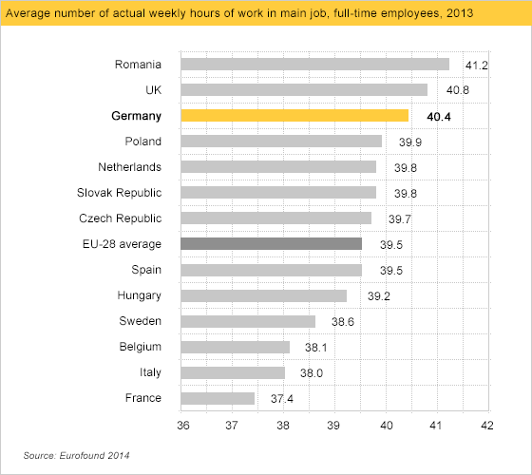
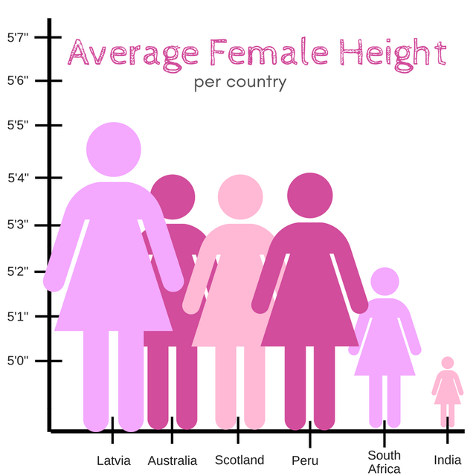
1. Bar chart y-axis (dependent variable) need to include zero

Slide 4
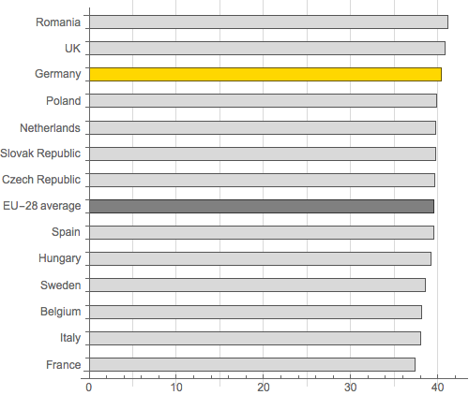
1. Bar chart y-axis (dependent variable) need to include zero

Slide 5
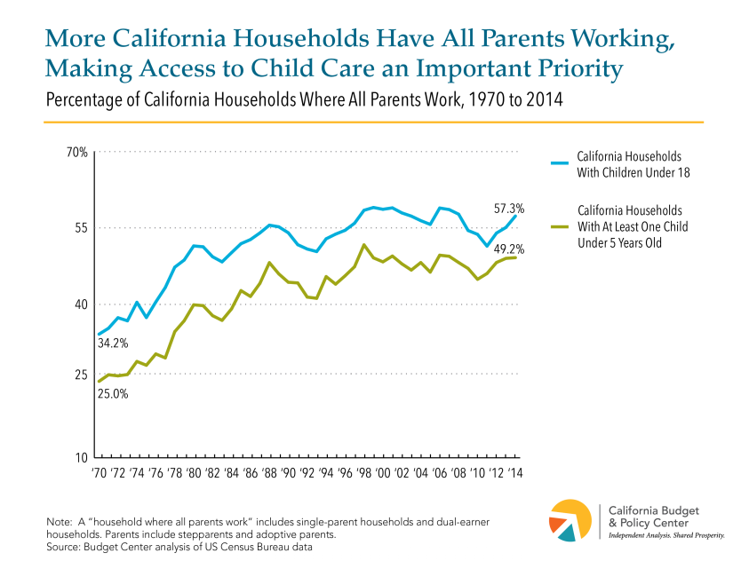
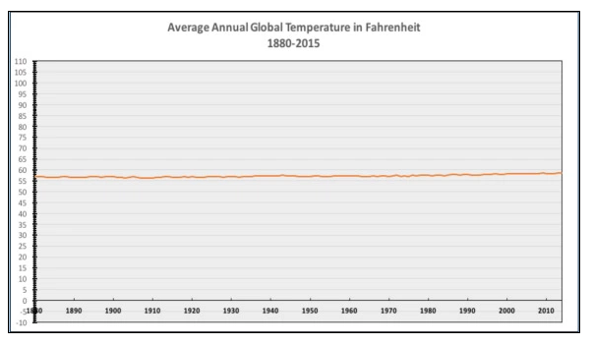
2. Line graph y-axis don’t need to include zero zero
Notes:
-Bar graphs emphasise the absolute magnitude of values associated with each category. In contrast, line graphs emphasise the change in the dependent variable (usually the y-axis) as the independent variable (usually the x-axis) changes.
-Therefore, the starting point may be a value different than 0!

Slide 6
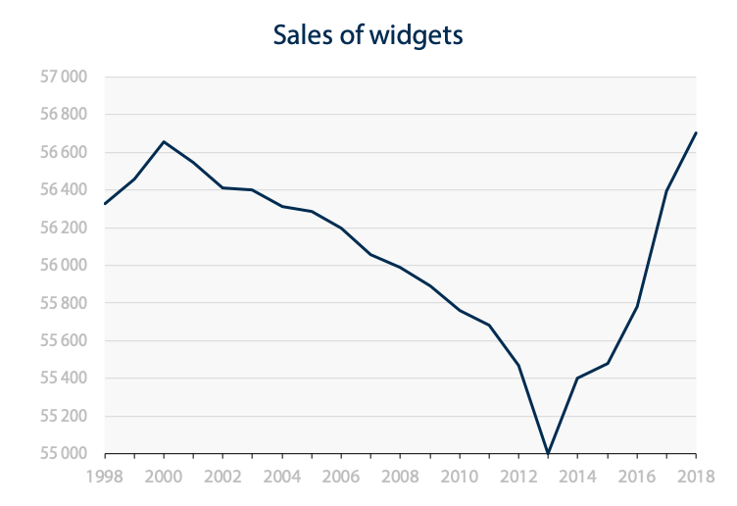
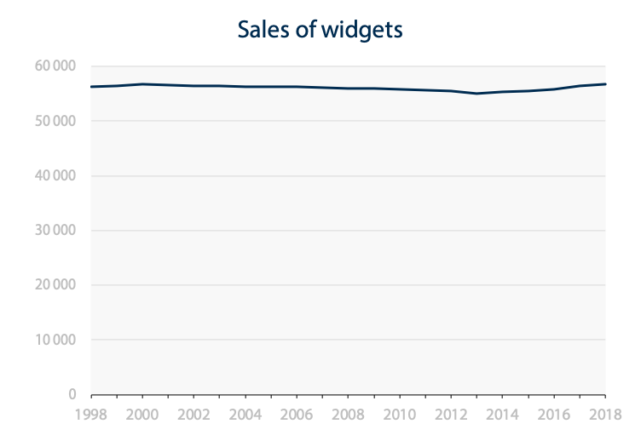
Well…
Notes:
-If you “fit” the line graph, then it can be misleading! The plot in the left is more “dramatic” than the one in the right!

Slide 7
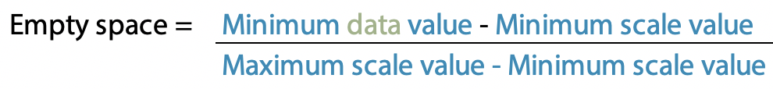
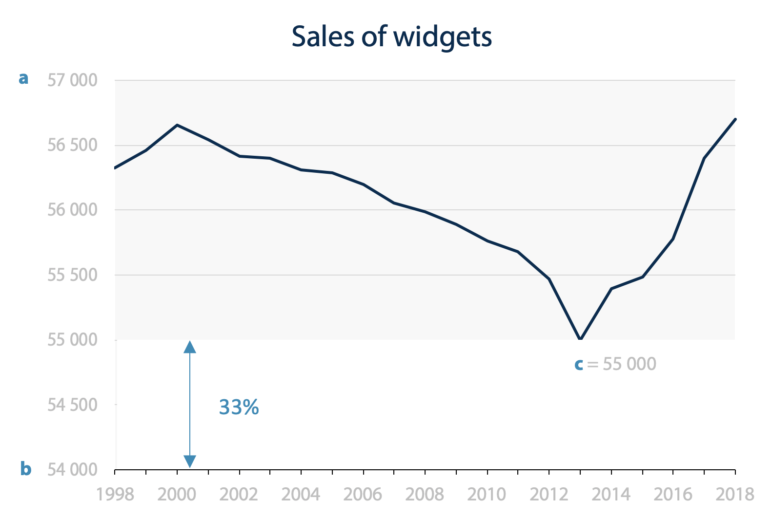
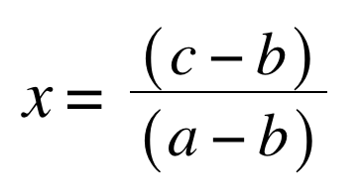
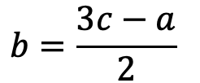
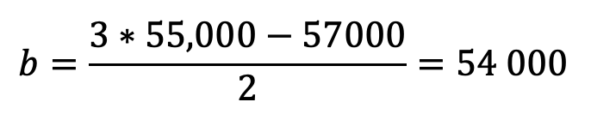
Solution
Gagnon, F. (2018). A golden ratio for line charts with truncated y-axis
Notes:
-The link contains a blog post talking about the fact that line graphs that do not include zero should include a whitespace between the lowest point and the x-axis.

Slide 8
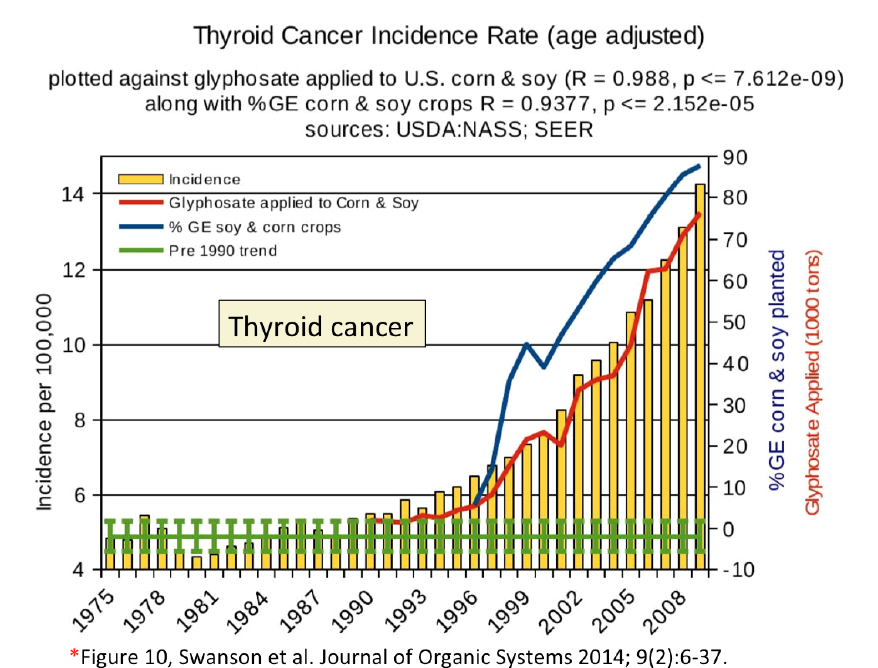
3. No multiple axes on a single graph
How to solve this?
Notes:
-The graph illustrates a temporal correlation between thyroid cancer and the use of glyphosate in soy and corn.
-The axis on the left, corresponding to the bar chart, doesn't go to zero.
-Both the scale and the intercept of the other vertical axis (on the right) have been adjusted so that the red curve traces the peaks of the yellow bars (they have hacked the graph to enforce correlation).
-To make the curves do this, the right axis has to go all the way to -10% GE corn planted, which is -10,000 tons glyphosate used!
-Axis need not to go to zero, but the fact that the right one needs to go to negative numbers is alarming…

Slide 9
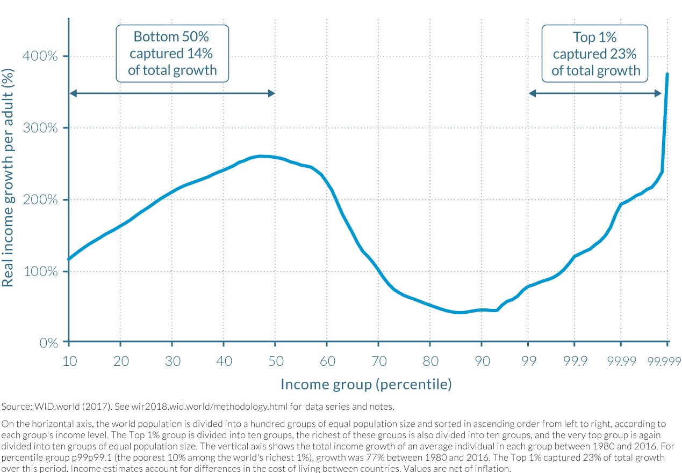
4. An axis should not change scales midstream
Use log scales!
Is this plot using the “golden ratio”?
Notes:
-The graph reproduced below from World Inequity Report 2018 illustrates the growth in real income from 1980 to 2016 for the combined populations of China, India, US-Canada, and Western Europe.
-At the far-right side of the graph, we have a population segment corresponding to less than 0.001% of the population living in a region the same size as used to represent the 10% of the population across the majority of the graph.
-It creates the impression that the high growth among top income brackets is broadly spread across the wealthier fraction of the population. This is misleading; the top 1% of the population occupies three-quarters of space along the horizontal axis as the bottom 50%.
-In a way, this is what happens with the first Pastafastarian plot since the last year’s period is 20 years instead of 40!
-Regarding the “golden ratio”, the rule is NOT applicable here because if we use the formula, b would be a negative number, and it doesn’t make sense to show negative percentages in this case (since it is growth).
b=(3c-a)/2=(3*50-350)/2=-100

Slide 10

Example (of what NOT to do)

Slide 11

Example (of what NOT to do)

Slide 12



Slide 13
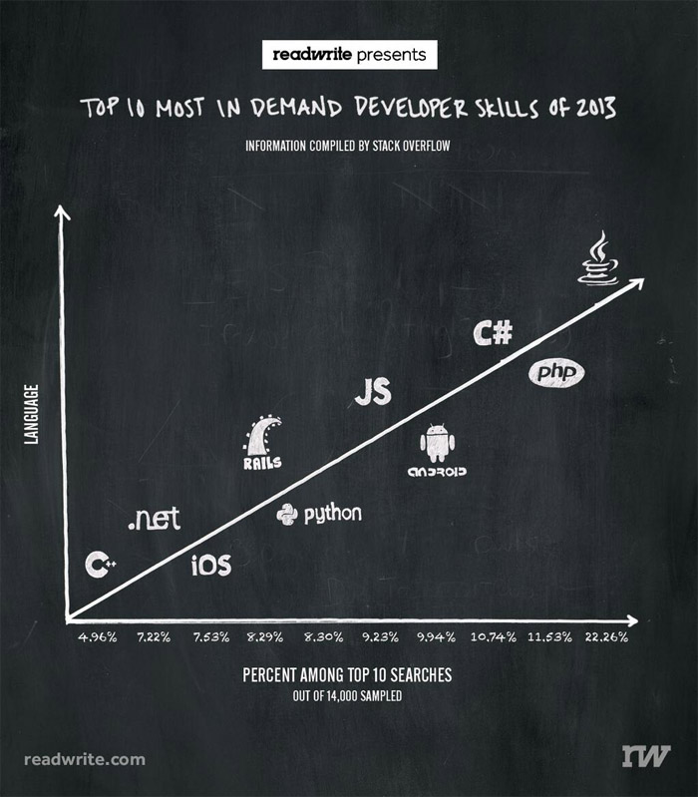
5. An axis should have something on it
Notes:
-Categorical variable are not appropriate for display using a line graph.

Slide 14
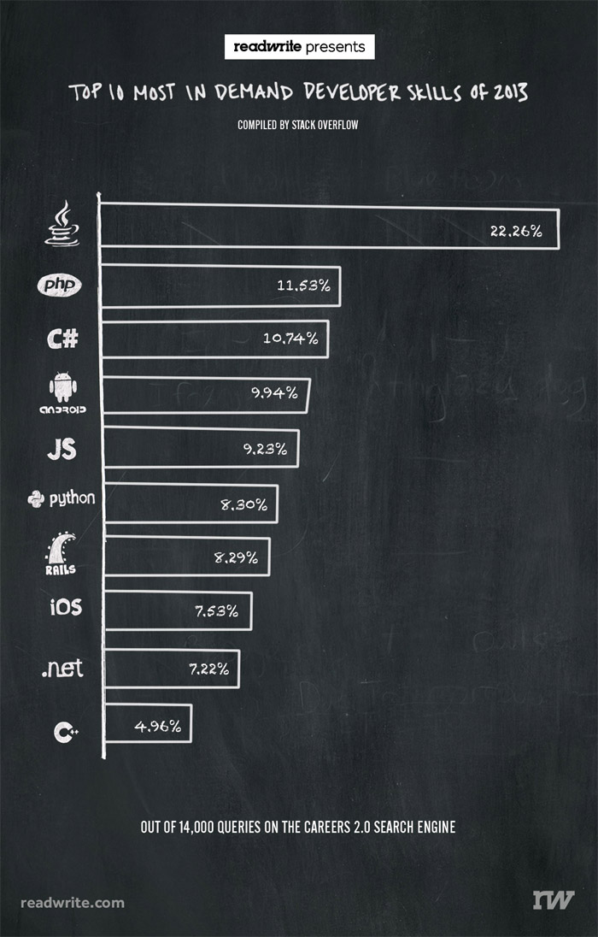
Like this
Tools such as WebPlotDigitizer can help you get the missing info

Slide 15
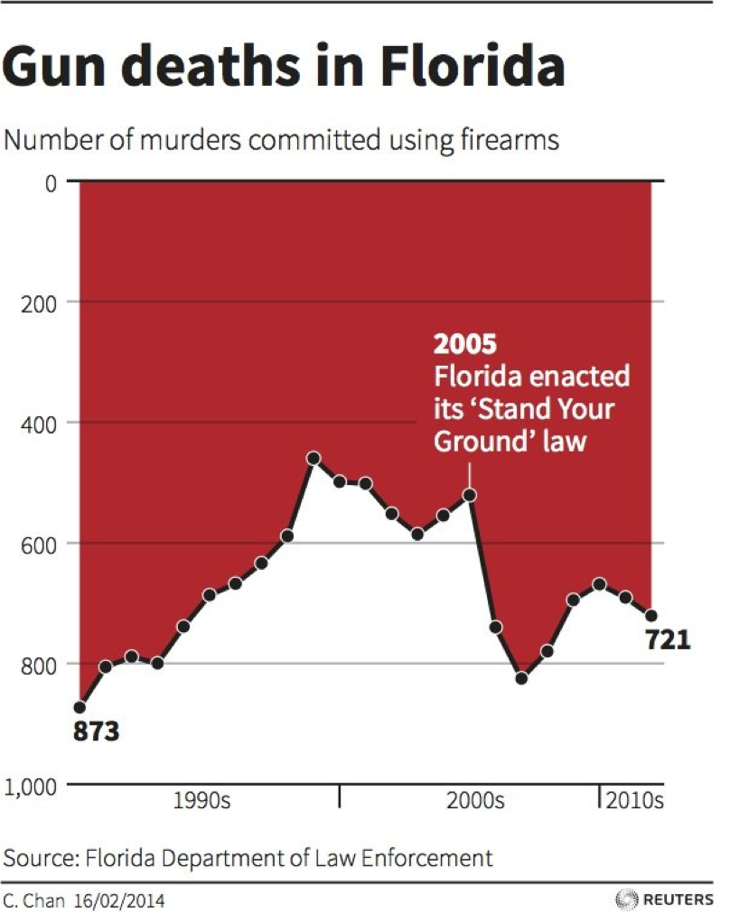
6. Don’t invert the axis(?)
The author defended it!
What’s your stance?
Notes:
-Author’s view was that deaths are negative things and should be represented as such.

Slide 16

7. Avoid extrapolation!

Slide 17
8. Proportional Ink
“When a shaded region is used to represent a numerical value, the area of that shaded region should be directly proportional to the corresponding value”
Extends the argument for misleading axes

Slide 18
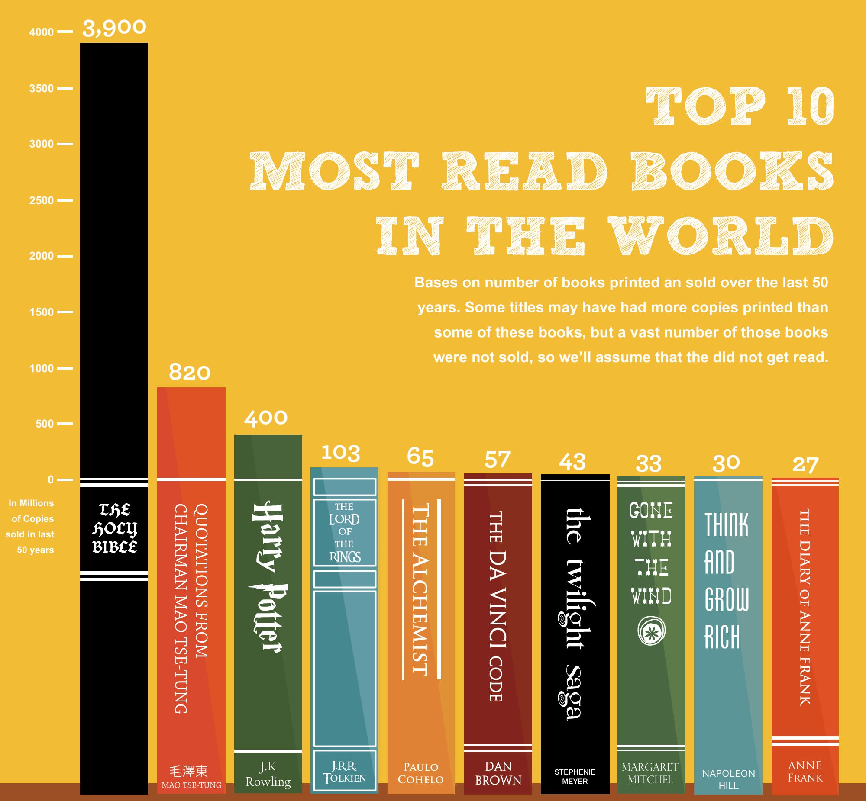
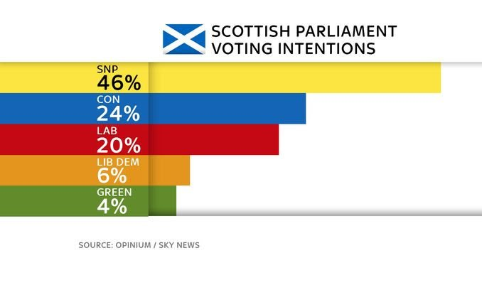
Notes:
This type of aesthetics just make the lower percentages look larger!

Slide 19
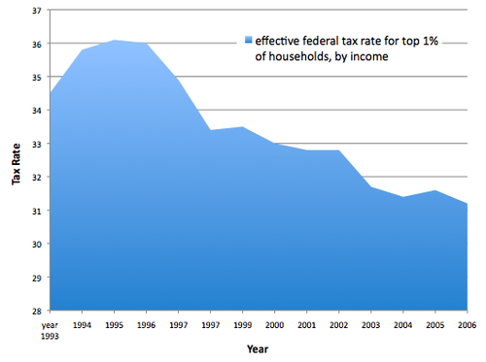
Notes:
A filled line chart must have an axis going to zero, otherwise the ink used misrepresents what is really happening

Slide 20
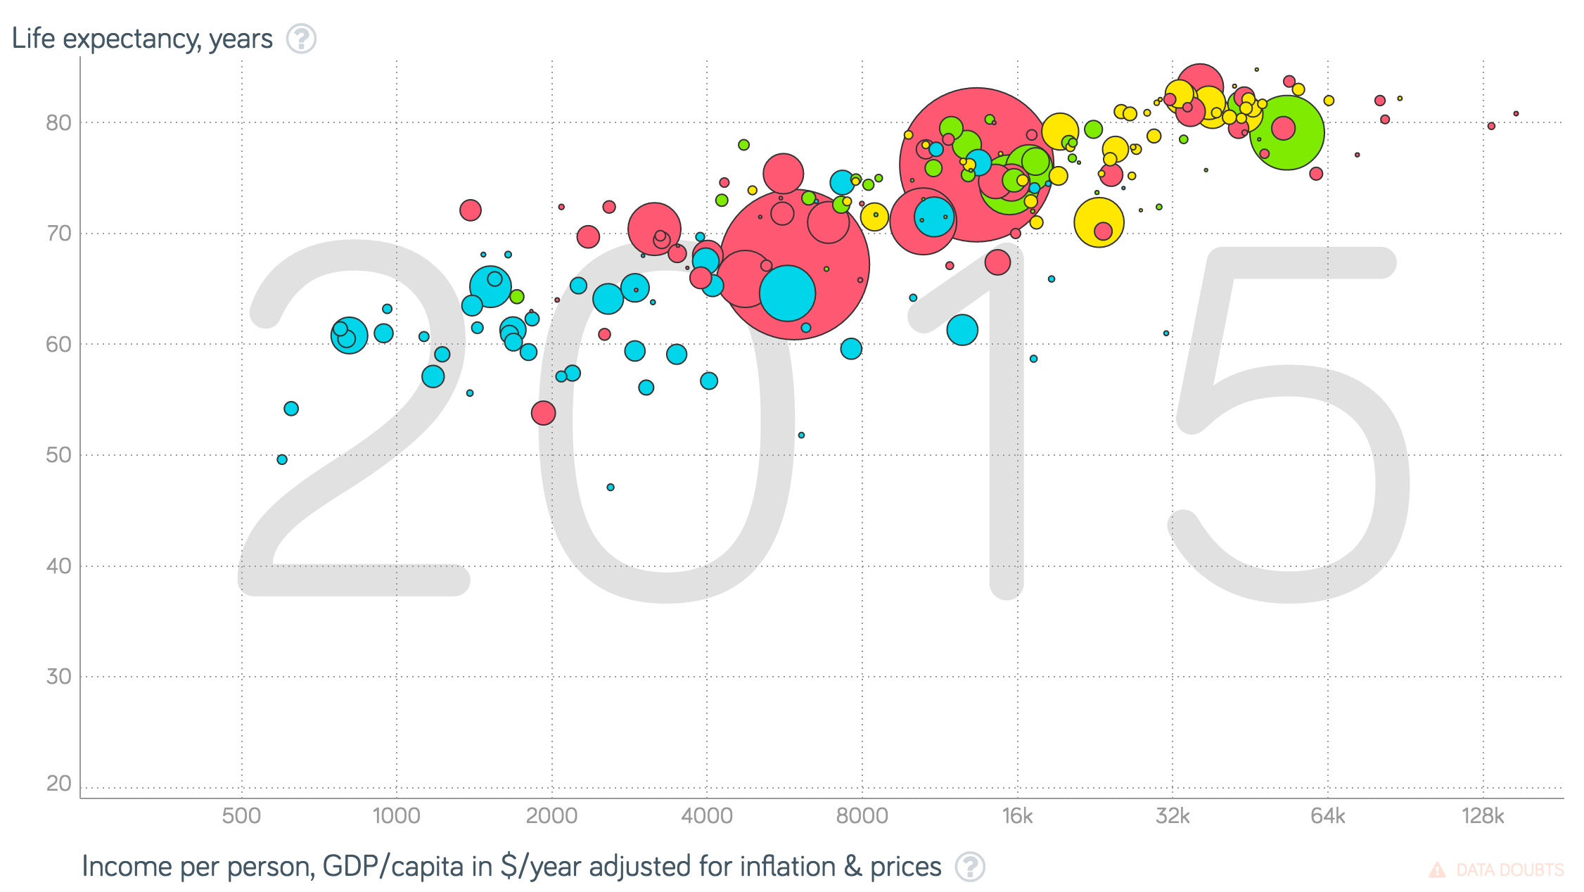
Should we violate the principle?
Notes:
-Bubble charts: X, Y, Size, Colour.
-Problem: X & Y compare while colour/size identify!
-Hard to compare with so much difference in population.

Slide 21
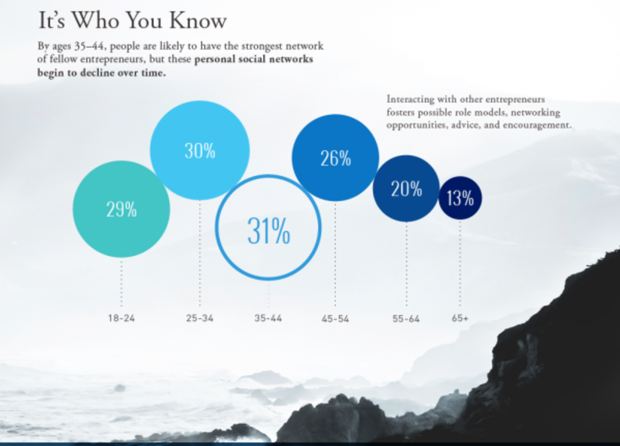
Radius ≠ Area
Notes:
-In this diagram, the 65+ disk has one half the radius than the 46-54 one, but this translates into one fourth the area.

Slide 22
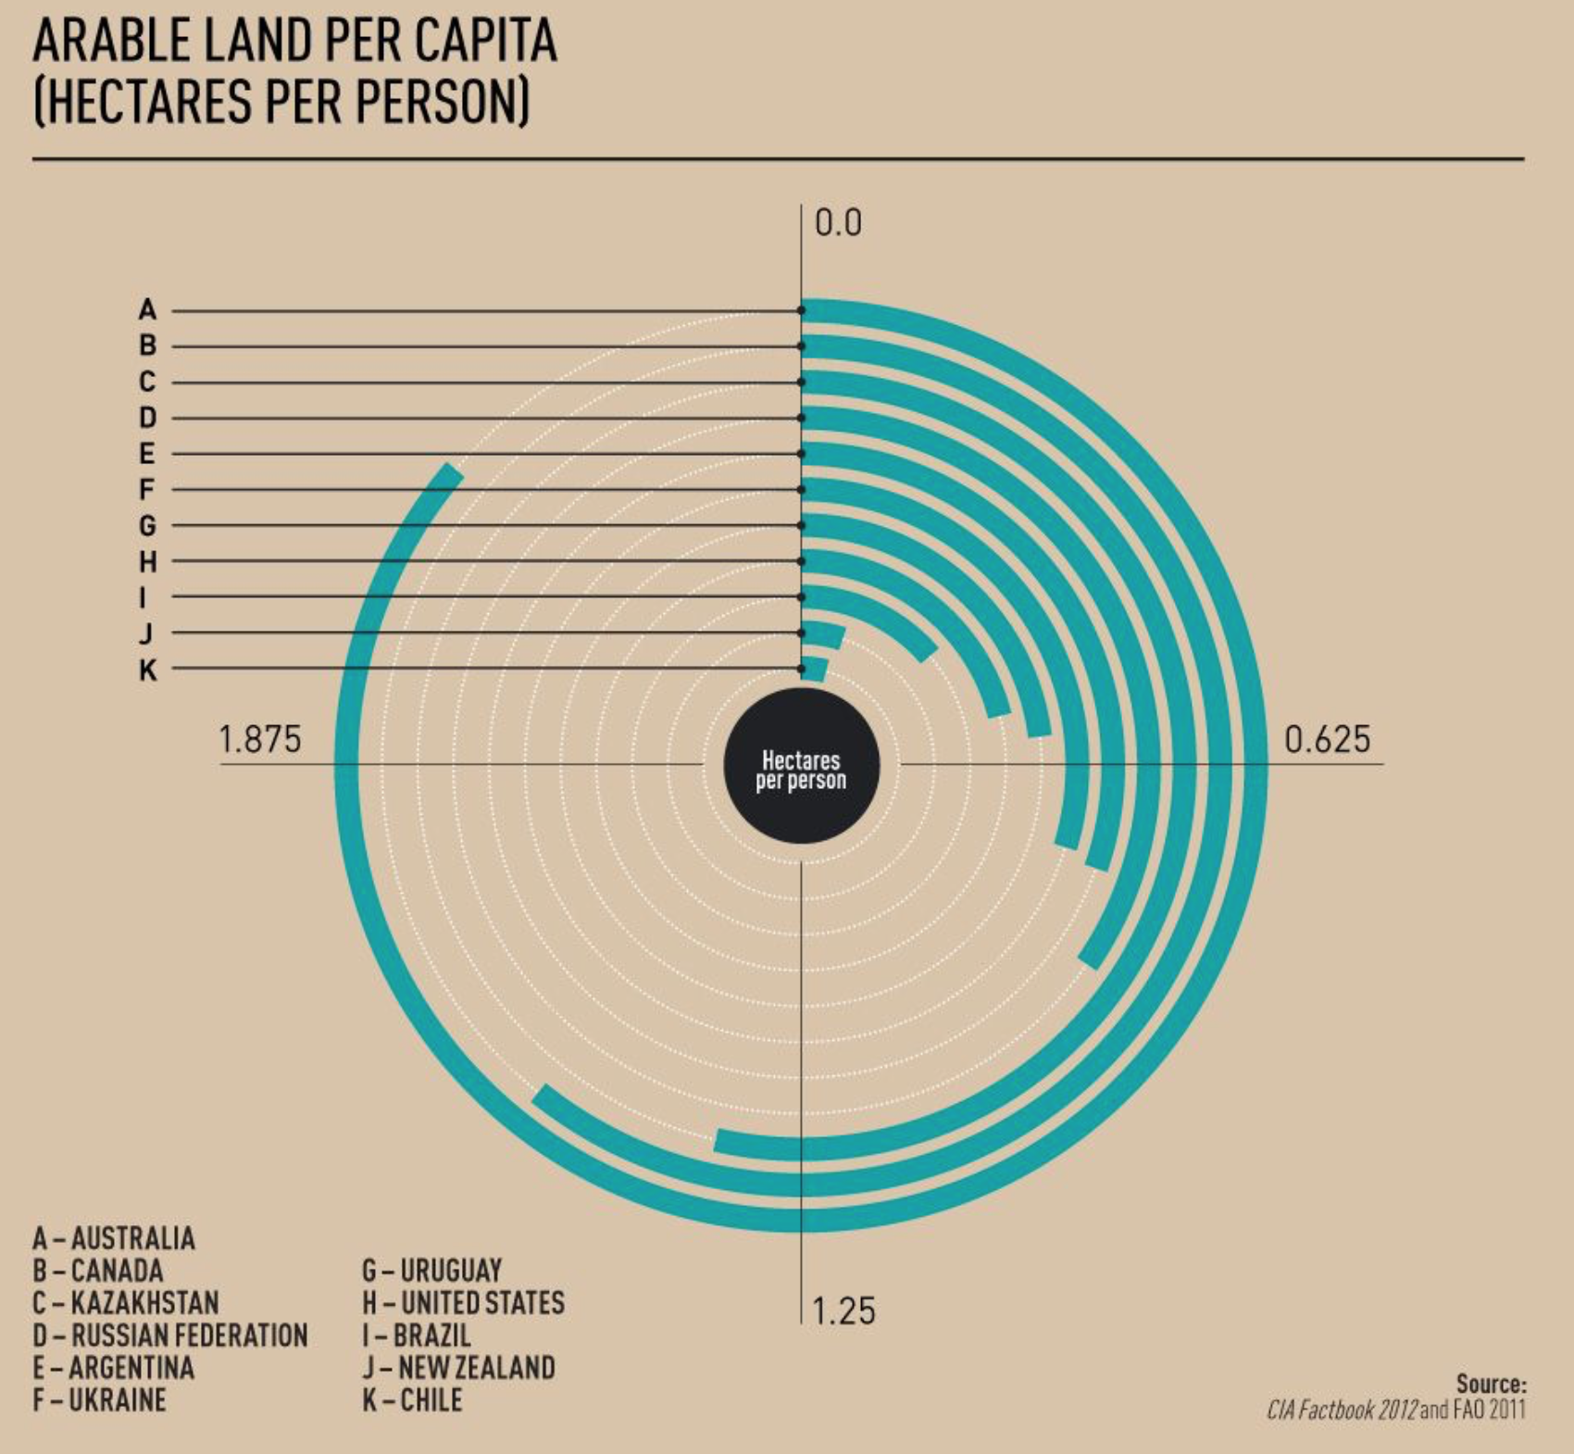
Notes:
“Donut” chart
Why letters?
Outer circles will get more ink than inner ones! (like in a race, athletes cannot start aligned)
THERE ARE SOME EXAMPLES OF THIS IN THE BOOKS!

Slide 23
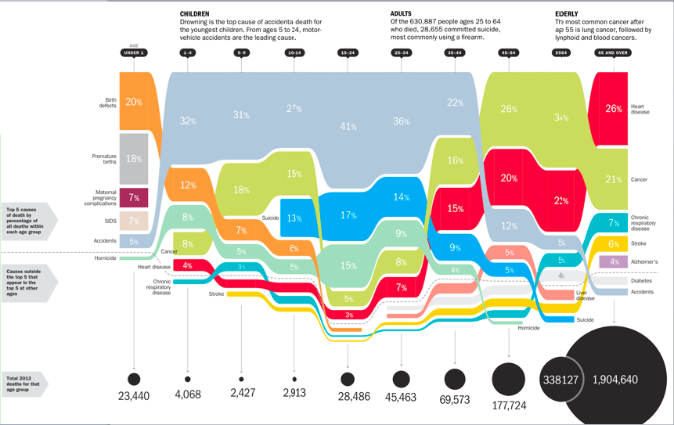
https://time.com/3935281/what-are-my-health-risk-factors/
Notes:
-This one appeared in a Time Magazine article, and illustrates the most common causes of death, by age group
-Too much info in a single figure!

Slide 24
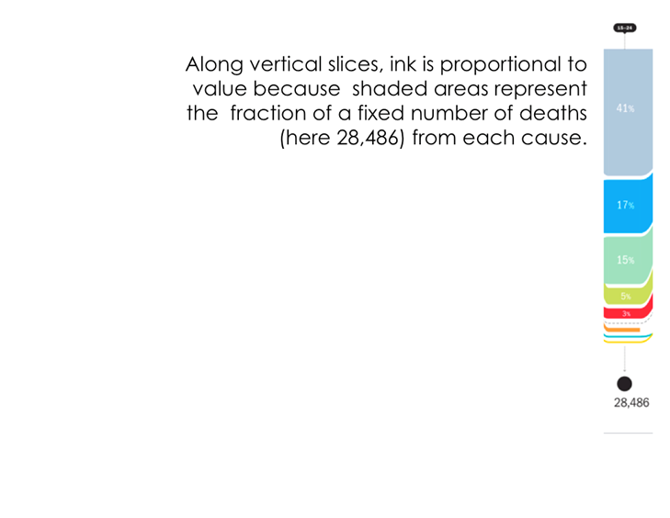
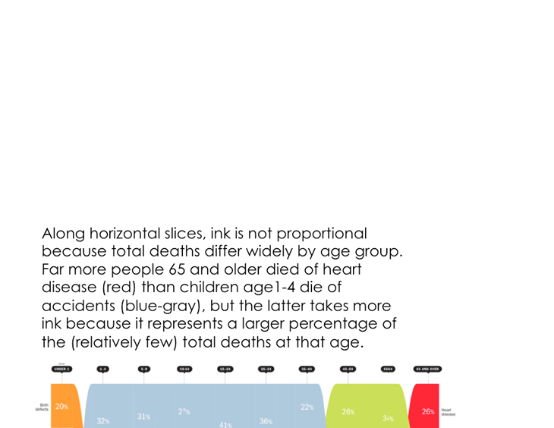
Notes:
-If you look vertically into a single point, it appears that there is proportional ink.

Slide 25
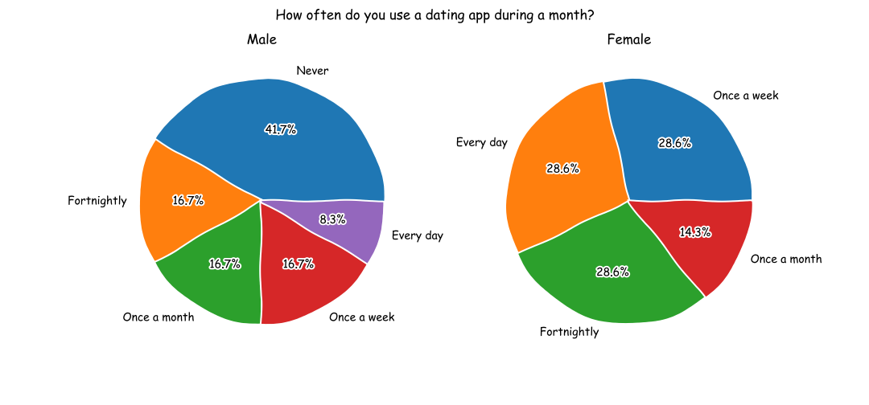
What is wrong in this one?
Notes:
In a way, this is misleading axis!

Slide 26
9. Perspective

Slide 27
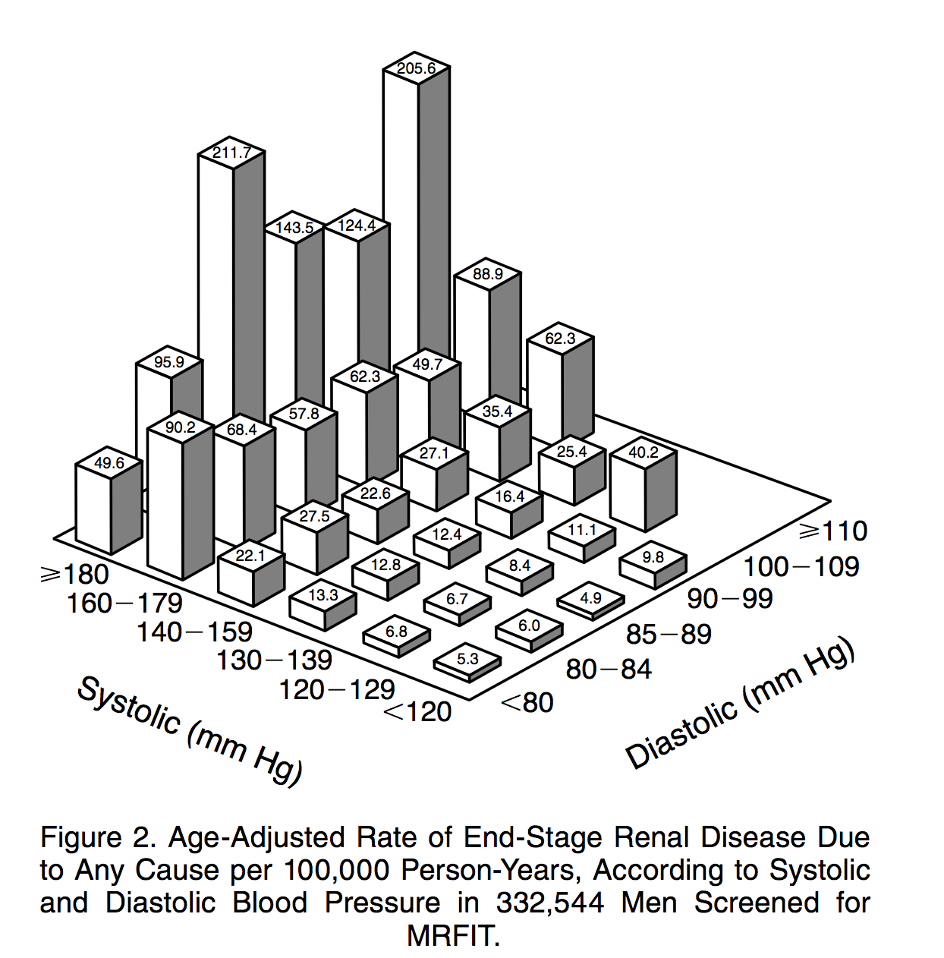
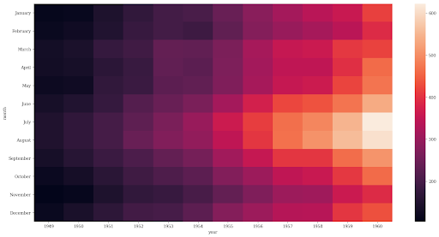
Notes:
-3D bar charts became popular in the 90’s as tools such as Matlab were capable of producing them
-By nature, they violate the proportional ink principle
-Moving from 2D to 3D offered no significant value
Both variables have to be high to lead to the disease!
-Alternative: Heatmap
Problem: Quantitative values are not well encoded in colours!

Slide 28
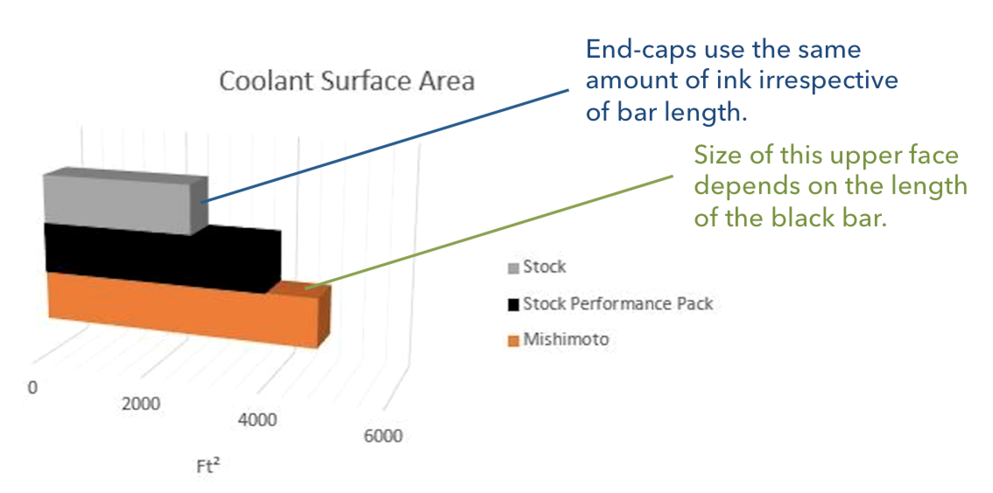
Notes:
-End-caps extend the effective visual length of each bar (grey is larger than orange).
-They used black in the second bar, which doesn’t allow to see the end cap.
-Angle makes it difficult to assess the length.
-Black wasn’t a good choice either.

Slide 29
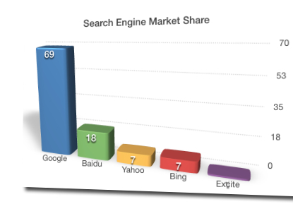
Notes:
-The horizontal gridlines are not parallel.
-Bars towards the left are shorter and use less ink.

Slide 30
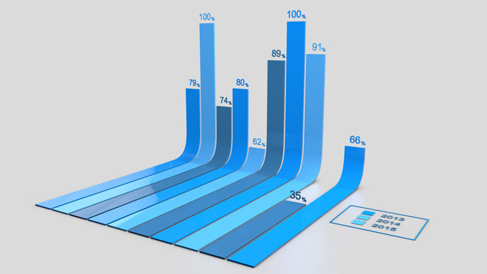
Notes:
JAIL!

Slide 31
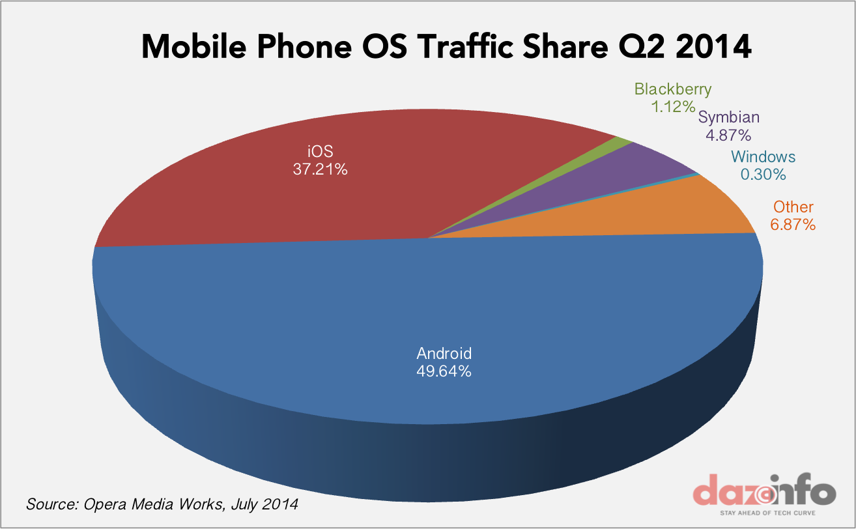
Notes:
-Pie charts are usually hard to assess because of their radial nature

Slide 32
10. Don’t jump into early conclusions

Slide 33
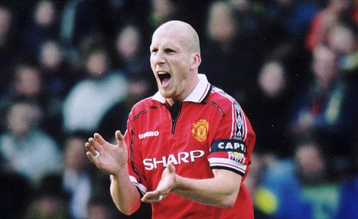
Anyone knows who this is?
Notes:
The story comes from the book “Expected Goals” by Rory Smith. Jaap Stam was sacked from Manchester because data showed he made fewer tackles. Nonetheless, this was NOT a symbol of him being a lousy defender; quite the opposite, he was becoming a better defender with better field awareness, positioning on the field and ball recovery. Manchester United will eventually regret this decision (not the first one!)

Slide 34
Is there a way to choose the “right” plot?

Slide 35
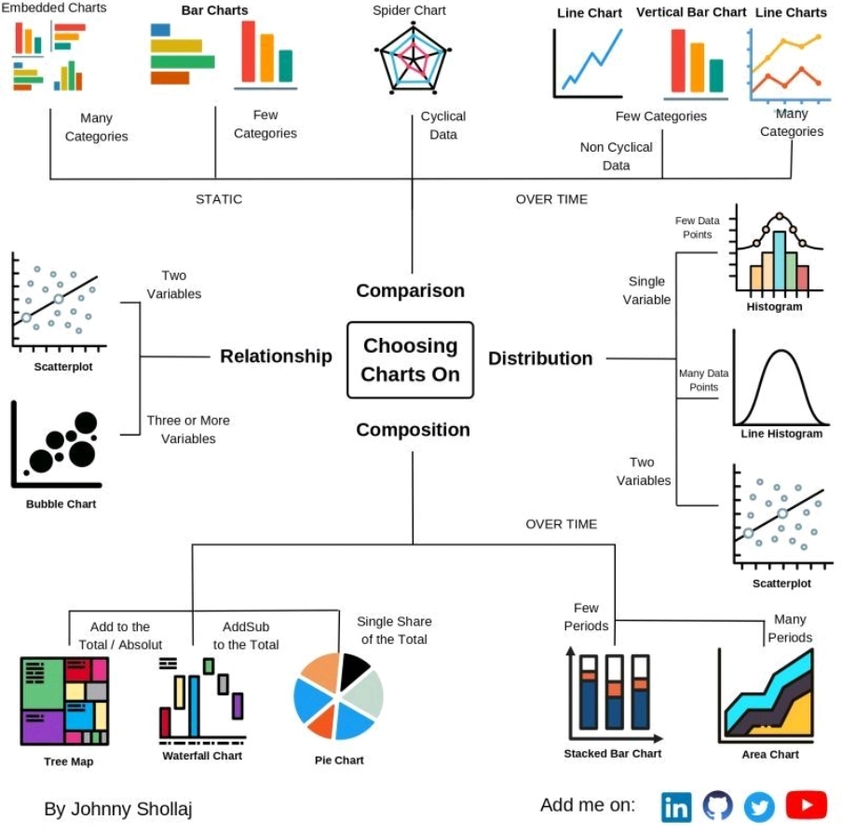

Slide 36
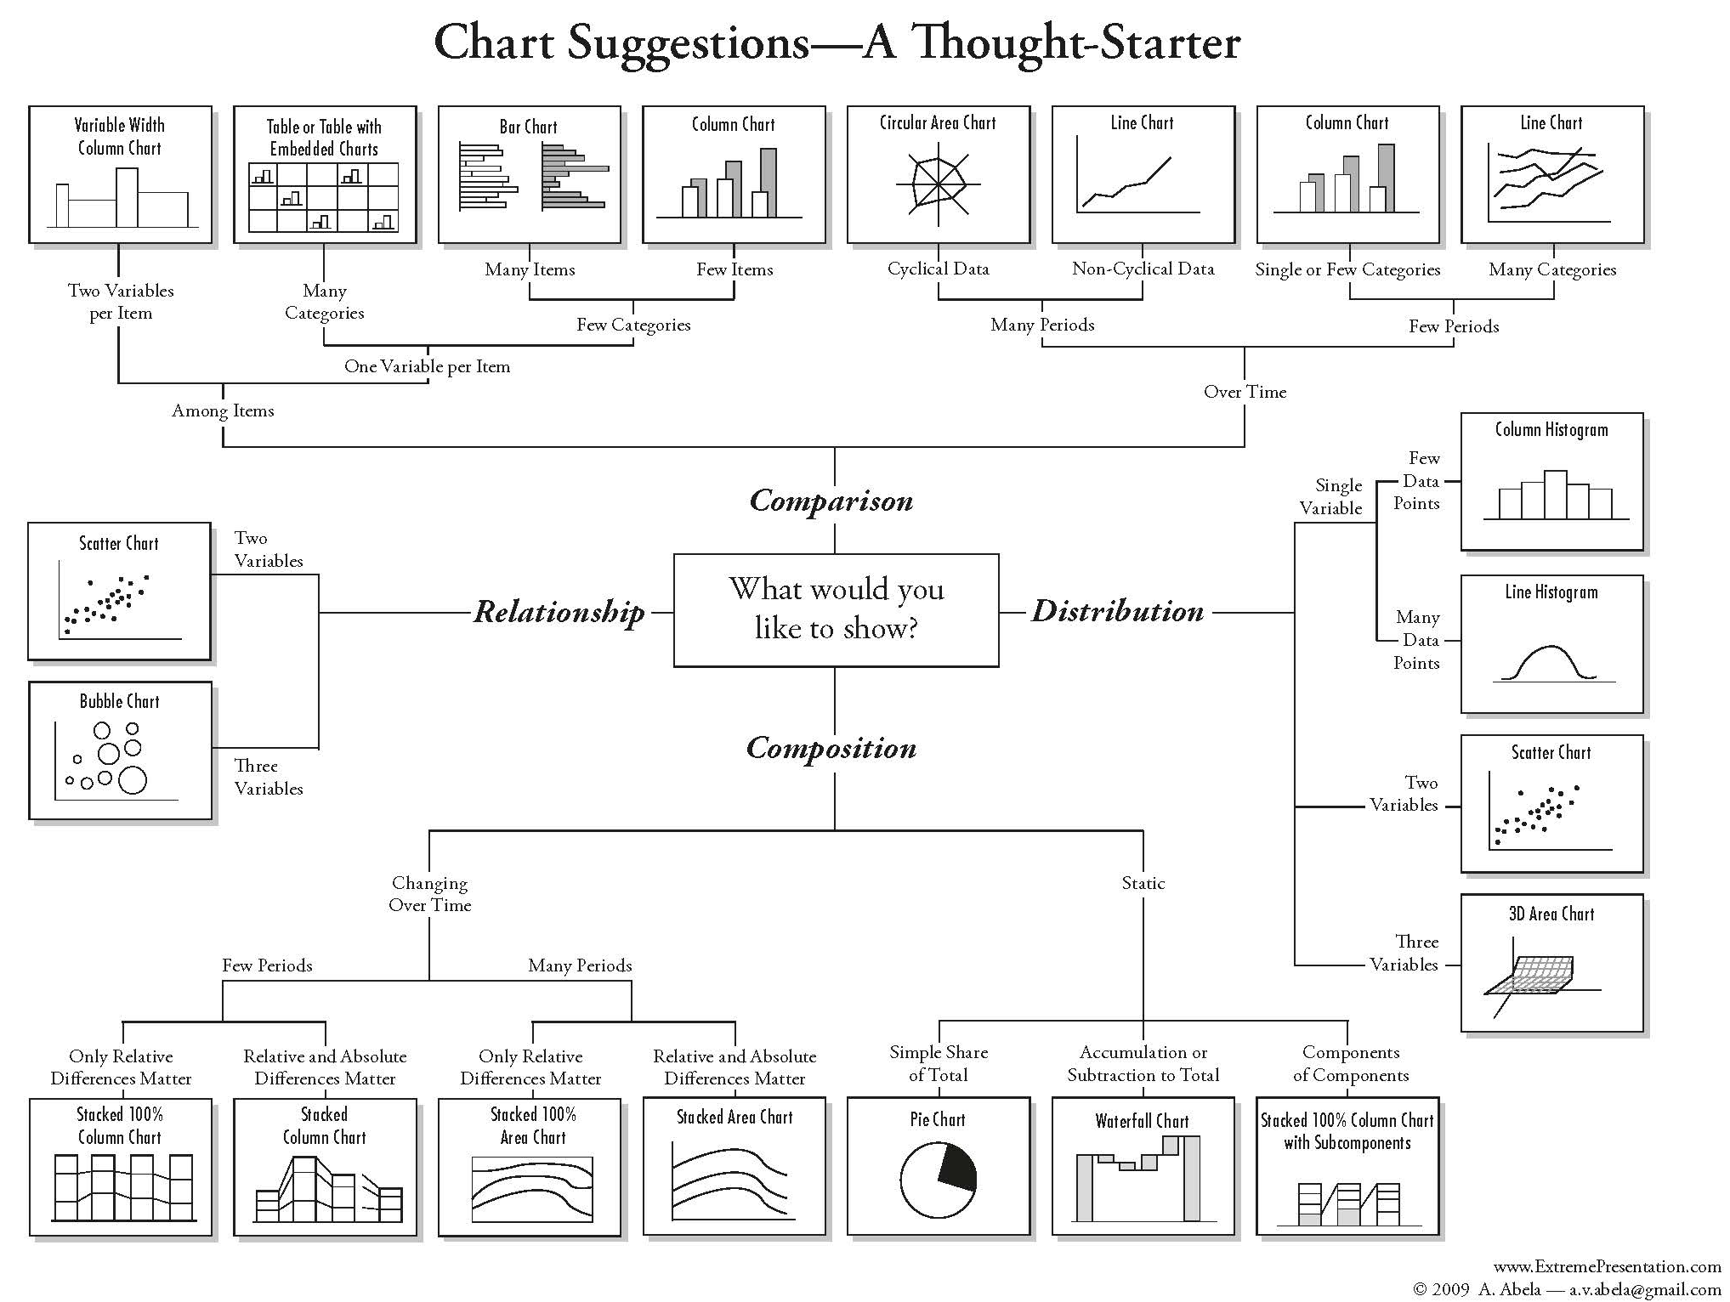

Slide 37
